Slide 1


Over the Top
By Group 9
Notes:
10

Slide 2
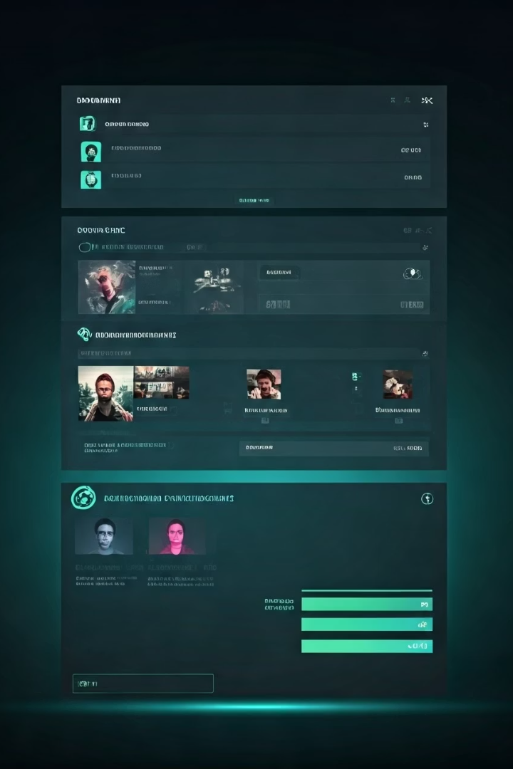
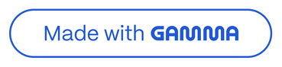
Project Overview
Welcome to our comprehensive overview of the database for a cutting-edge OTT streaming platform. This project delivers a robust system that manages users, subscriptions, content, engagement metrics, and business analytics.
Our solution provides a scalable, secure foundation that supports both day-to-day operations and strategic decision-making. Through careful design and implementation, we've created a system that will grow with your business while delivering actionable insights.
Notes:
1

Slide 3
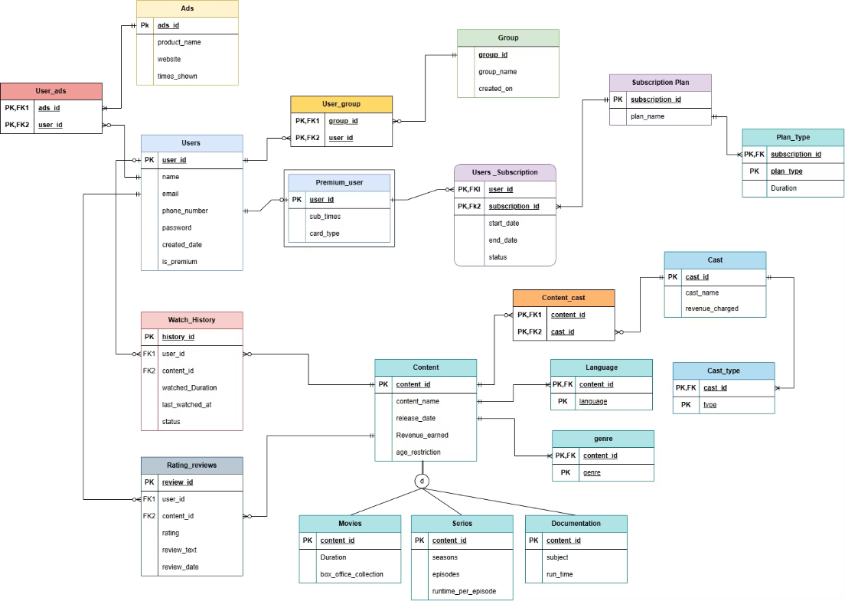
ER Diagram
Notes:
3

Slide 4
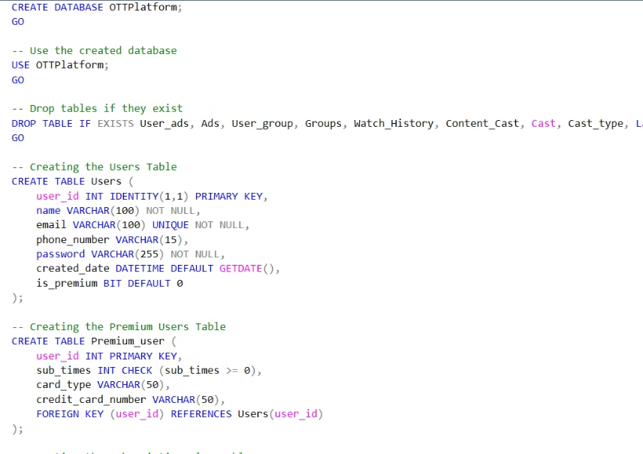
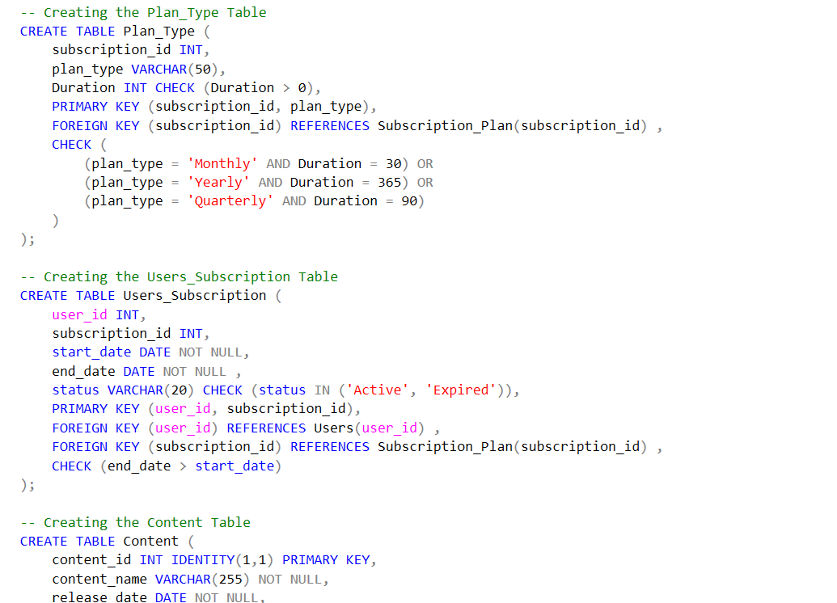
DATA DEFINITION
Table Schemas
Carefully designed tables with appropriate data types, constraints, and relationships. For example, the Users table includes essential fields like user_id, name, email, and password with appropriate constraints and Foreign key relationships enforce data consistency between tables. Check Constraints to ensuring data integrity and enforcing business rules at the database level
Notes:
4

Slide 5
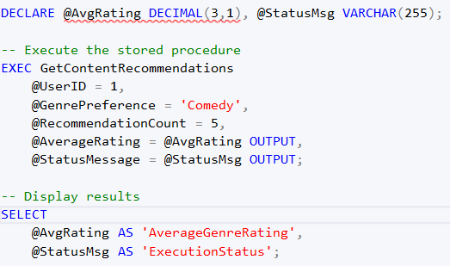
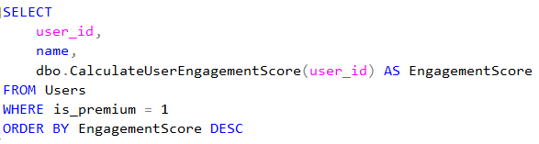
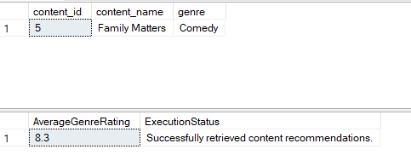
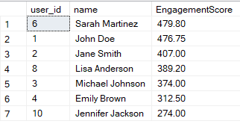
STORED PROCEDURES
User Defined Functions
GetContentRecommendations: Recommends content by genre preference, excluding watched items, and calculates average genre ratings.
UpdateUserSubscription: Manages subscription updates (expires old plans, activates new ones) and upgrades users to premium.
GetUserContentAnalytics: Tracks total watch time, identifies favorite genres, and returns detailed viewing/rating history for a user
CalculateUserEngagementScore: Computes a user’s engagement score (0-100) based on content diversity, watch duration, reviews, and ratings.
GetContentSimilarity: Measures similarity (%) between two content items using shared genres, languages, and cast members.
CalculateContentAffinityScore: Quantifies a user’s affinity (0-100) for a specific genre using watch history and ratings
Notes:
5

Slide 6
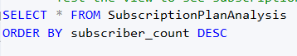
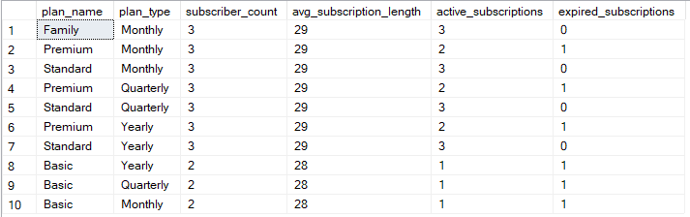
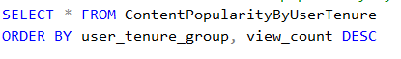
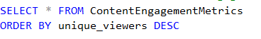
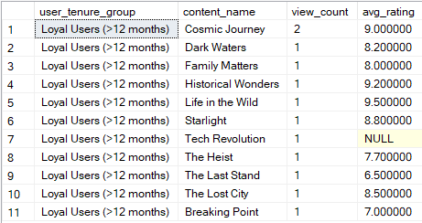
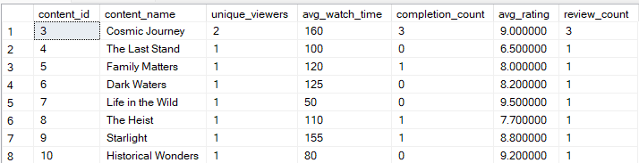
Views
ContentPopularityByUserTenure: Groups users by account age (new/regular/loyal) and shows content popularity/ratings per group.
SubscriptionPlanAnalysis: Breaks down subscriptions by plan name/type, showing counts, durations, and active/expired statuses.
ContentEngagementMetrics: Aggregates viewer stats (unique viewers, avg watch time, completion rate, ratings) per content item
Notes:
5

Slide 7
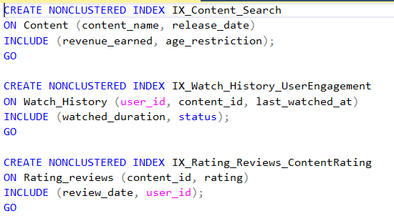
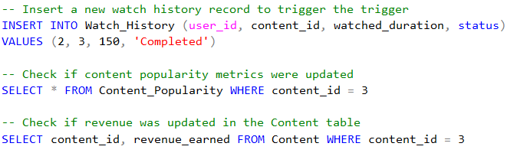
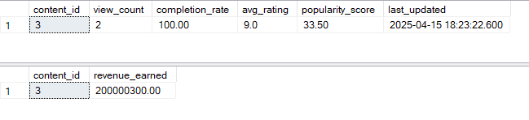
Indexes
IX_Content_Search:-Optimizes search queries on the Content table by indexing content_name and release_date, with additional data (revenue_earned, age_restriction) included for faster retrieval.
IX_Watch_History_UserEngagement:- Enhances performance for queries analyzing user engagement in the Watch_History table by indexing user_id, content_id, and last_watched_at, while including watched_duration and status.
IX_Rating_Reviews_ContentRating:-Speeds up queries related to content ratings in the Rating_reviews table by indexing content_id and rating, with additional columns (review_date, user_id) included for quick access.
Trigger
UpdateContentPopularity: Updates Content_Popularity and Content.revenue_earned in real-time after Watch_History changes

Slide 8
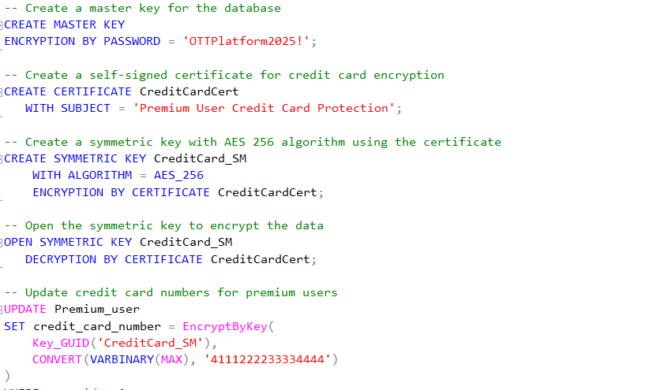
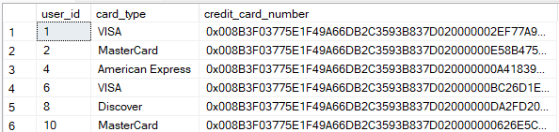
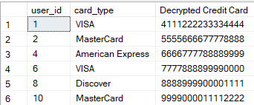
Encryption
A master key and a self-signed certificate were created in the database to enable encryption.
A symmetric key using the AES-256 algorithm was established for encrypting and decrypting credit card data.
The credit_card_number field in the Premium_user table is stored in encrypted form (VARBINARY(MAX)), ensuring that raw card numbers are never exposed in the database.
Encryption and decryption are performed using SQL Server’s EncryptByKey and DecryptByKey functions, with the symmetric key opened only when needed for secure operations.

Slide 9
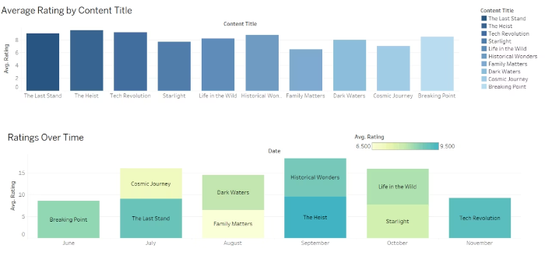
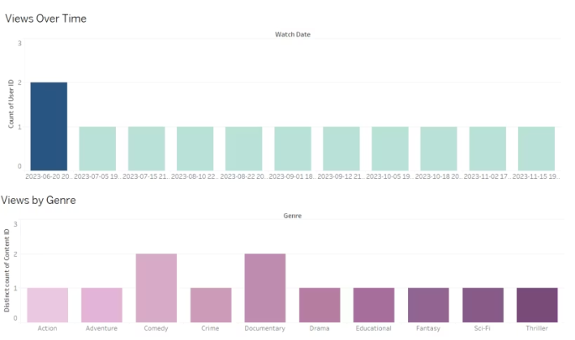
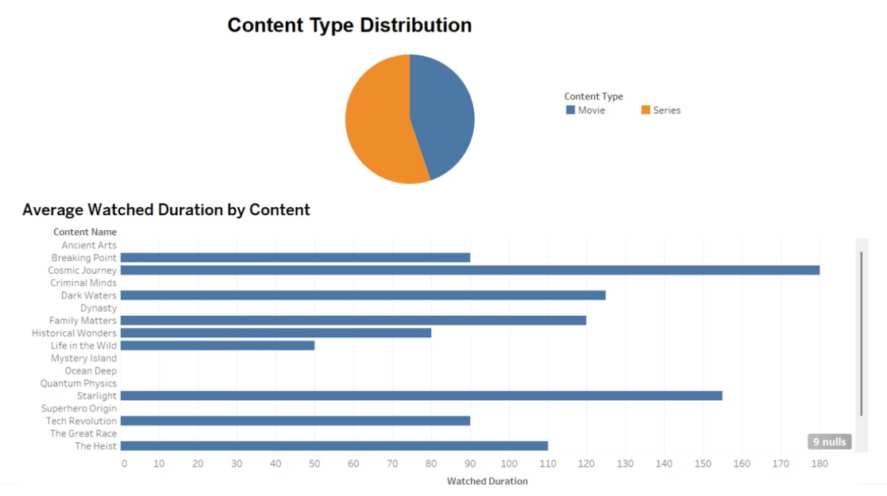
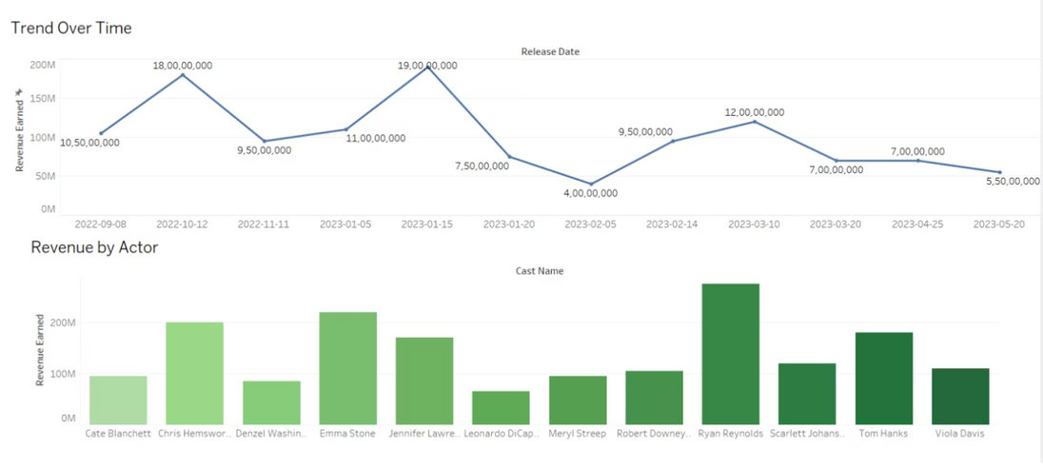
User Engagement & Content Insights
Notes:
6

Slide 10
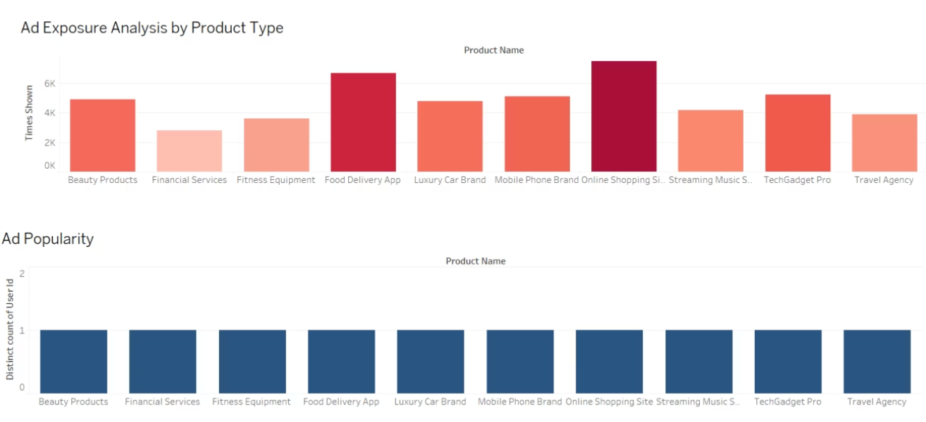
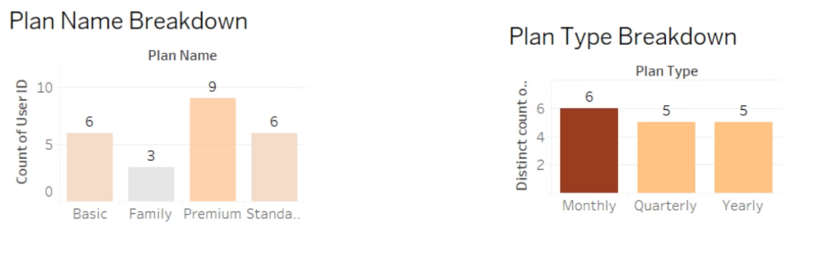
Subscription & Ad Engagment Analysis
Notes:
7

Slide 11
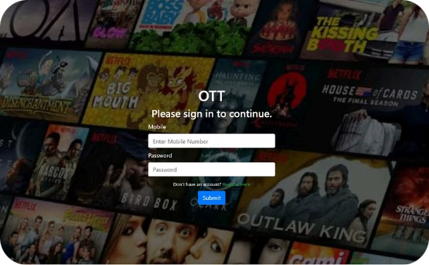
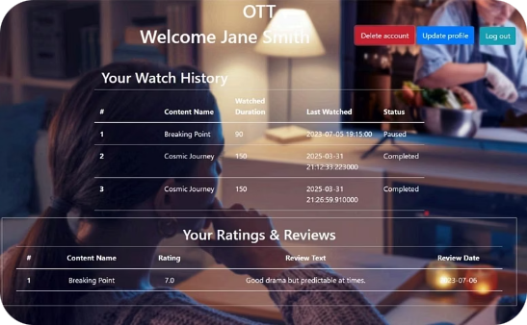
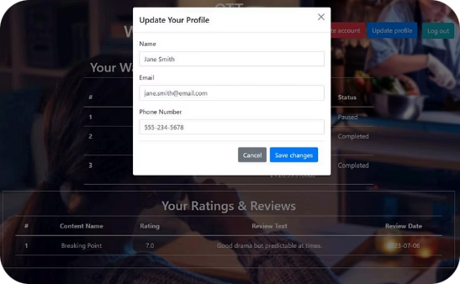
User Interface
Secure Authentication
Personalized Dashboard & Account Managment
Account Management
User-friendly login and registration screens with robust security measures to protect user accounts and personal information.
Comprehensive profile management with easy access to update account ,delete account and logout
Intuitive interface displaying watch history, ratings, reviews, and personalized content recommendations based on viewing patterns.
This OTT platform database project delivers a comprehensive solution that balances operational efficiency with strategic insight. The architecture is designed for scalability, allowing for future enhancements such as AI-powered recommendation engines or advanced user segmentation.
Notes:
9

Slide 12
Live Demo
Notes:
10

